Slide 1

Mushroom Classification: Edible vs. Poisonous
By – Nitesh Kumar Kesharwani
Date: 14-01-2024

Slide 2
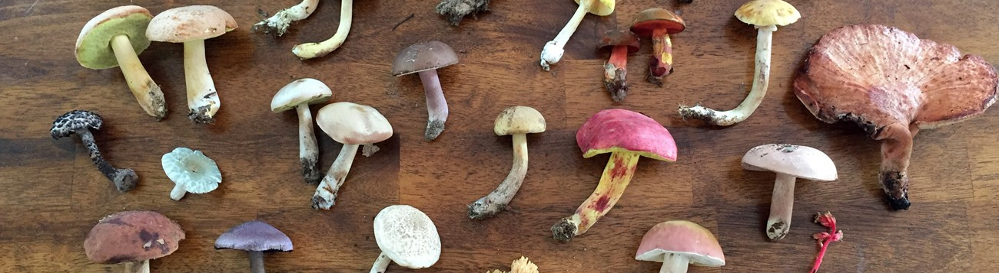
Importance of Classifying Mushrooms for Safety
Health Risks: Consuming poisonous mushrooms can lead to severe health issues, ranging from gastrointestinal problems to organ failure. Quick and accurate classification is crucial to prevent ingestion of toxic varieties.
Mushroom Foraging: Many individuals engage in mushroom foraging for culinary or recreational purposes. A reliable classification system ensures that foragers can confidently identify mushrooms in the wild, minimizing the risk of accidental poisoning.
Medical Applications: Some mushroom species have medicinal properties, while others can be harmful. A robust classification model aids researchers and medical practitioners in distinguishing between beneficial and toxic mushrooms for potential therapeutic uses

Slide 3
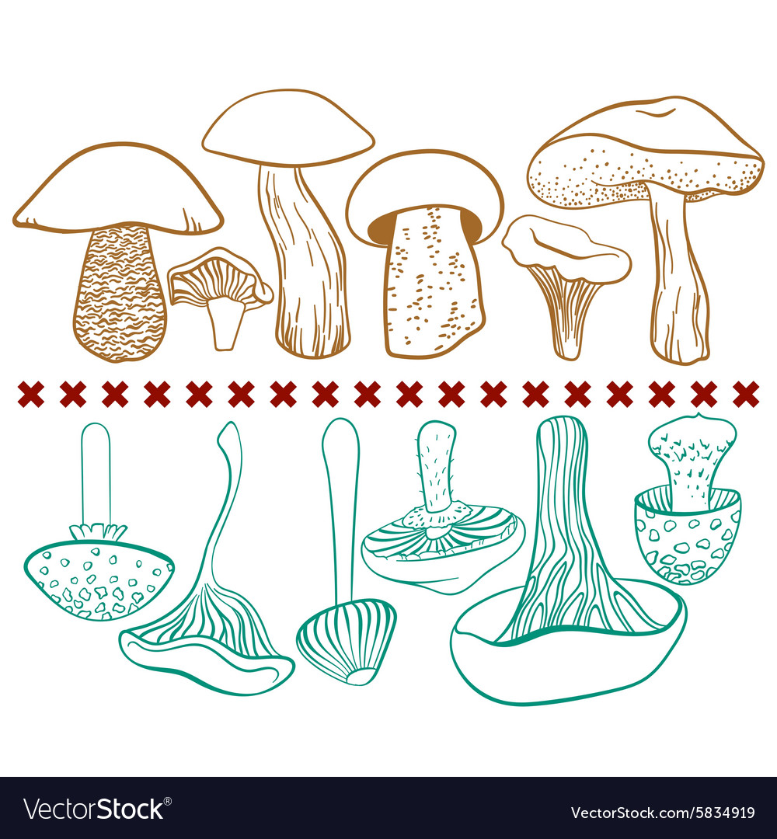
Problem Statement
The overarching objective of this project is to develop a robust and accurate machine learning model capable of predicting the edibility status of mushrooms, discerning between poisonous and edible varieties, leveraging a comprehensive set of features that encapsulate various attributes such as cap shape, cap surface, gill characteristics, stem dimensions, veil properties, and spore print color. Through extensive analysis and predictive modeling, the goal is to create a reliable tool for differentiating between mushroom types, ensuring the safety of individuals engaging in mushroom foraging or related activities.

Slide 4
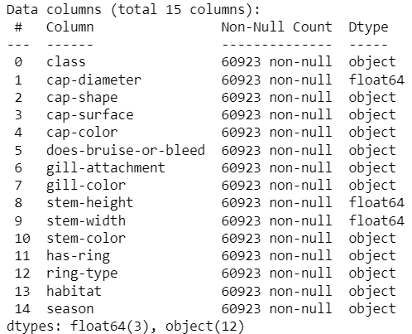
Data Overview
Number of Instances and Features:
The dataset consists of a total of 60923 instances, where each instance represents an individual mushroom observation. In terms of features, there are 14 distinct characteristics or attributes that describe each mushroom. These features encompass a variety of aspects such as cap diameter, color, gill characteristics, stem attributes, and more.

Slide 5
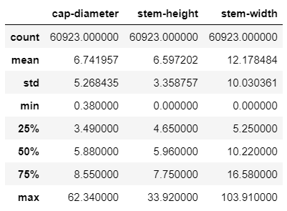
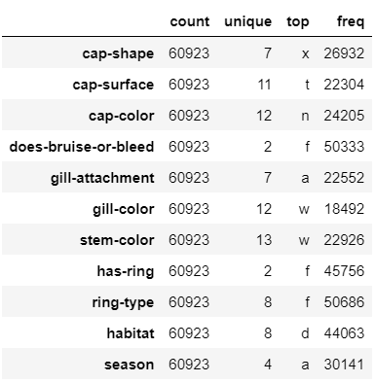
Brief Statistics on the Data
Numerical Features’ Analysis
Categorical Features’ Analysis

Slide 6
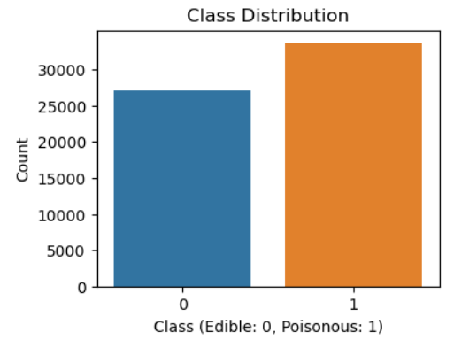
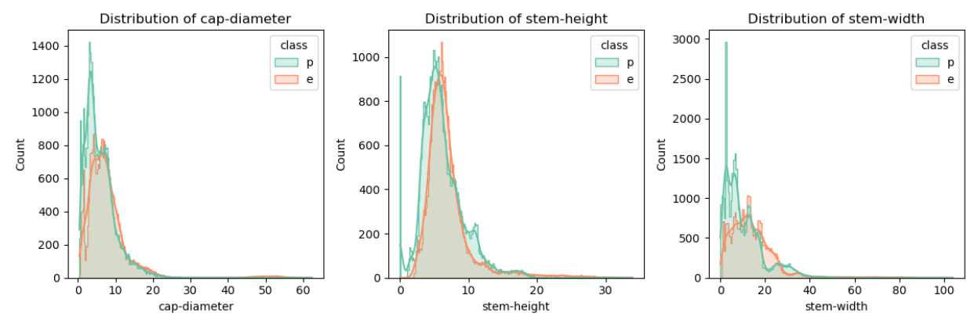
Exploratory Data Analysis (EDA)
Class Distribution: Class looks slightly imbalanced but not much ☺
Visualizations of Numerical Features:
Insights :
Numerical features such as cap-diameter, stem-height and stem-width are right-skewed
Stem-width distribution of poisonous mushrooms are very narrow while for edible it is equally spread
Stem-height distribution of both classes are overlapping, showing similar distribution between range 2 to 10 cm
Cap-diameter for poisonous mushrooms has very narrow distribution and majority ranging from 1 to 6 cm

Slide 7
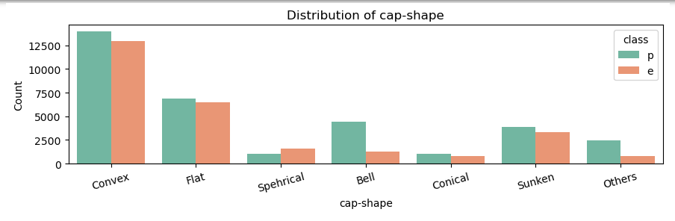
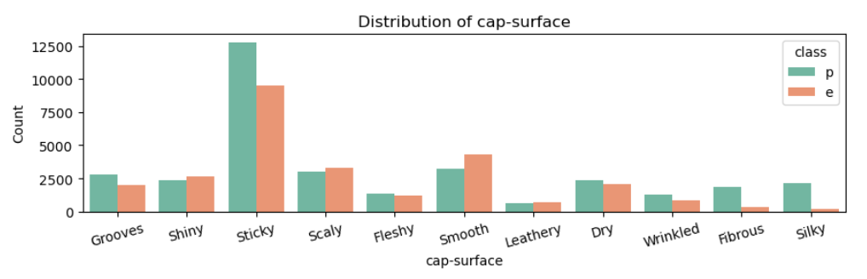
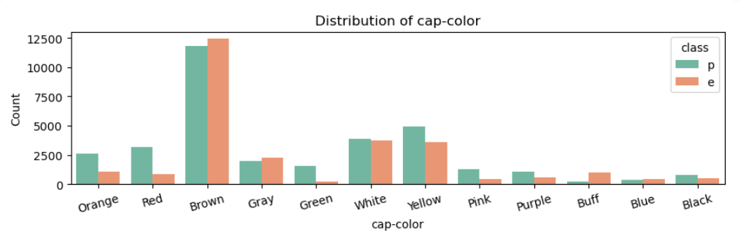
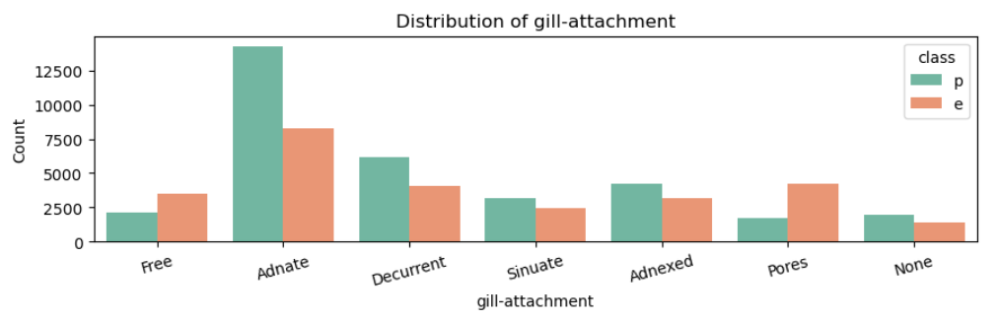
Exploratory Data Analysis (EDA)
Bell and Others cap-shape are clearly poisonous
Sticky, Fibrous and Silky cap-surfaced mushrooms have high possibility of being poisonous while smooth has chance of being edible
Distribution of cap-color shows that Orange, Red, Green, Yellow, Pink, Purple and Black are not edible
Mushrooms having Buff, Brown and Gray cap-color has chance of being edible
Gill-attachment of type Adnate, Decurrent are poisonous followed by Adnexed and sinuate
Gill-attachment of type Pores and Free are edible

Slide 8
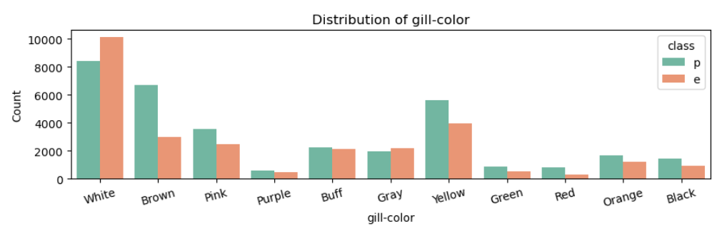
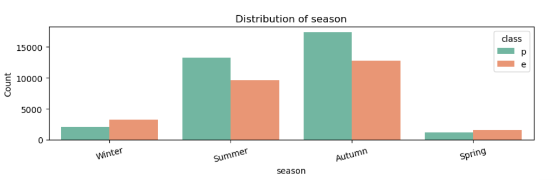
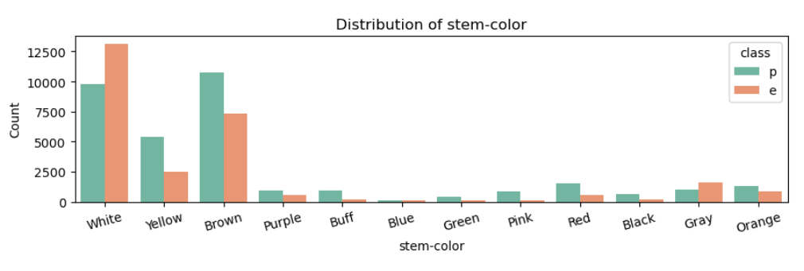
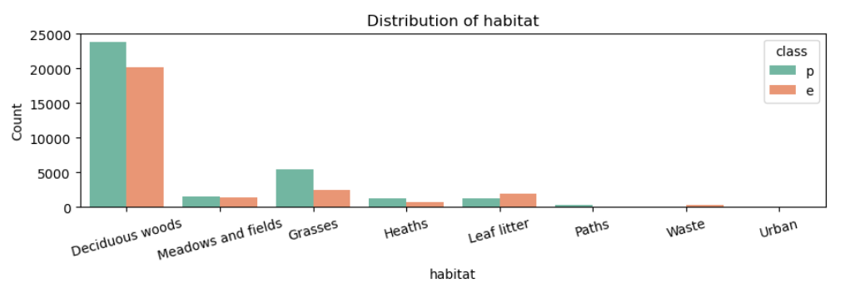
Exploratory Data Analysis (EDA)
Except White and Gray, other stem-color mushrooms have higher probability of being poisonous.
Similar to stem-color only white and Gray gill-color mushrooms has chance of being edible
Most of the poisonous mushrooms are from Summer and Autumn season
Only habitat with higher probability of edible mushrooms is Leaf litter, while others have higher probability of being poisonous

Slide 9
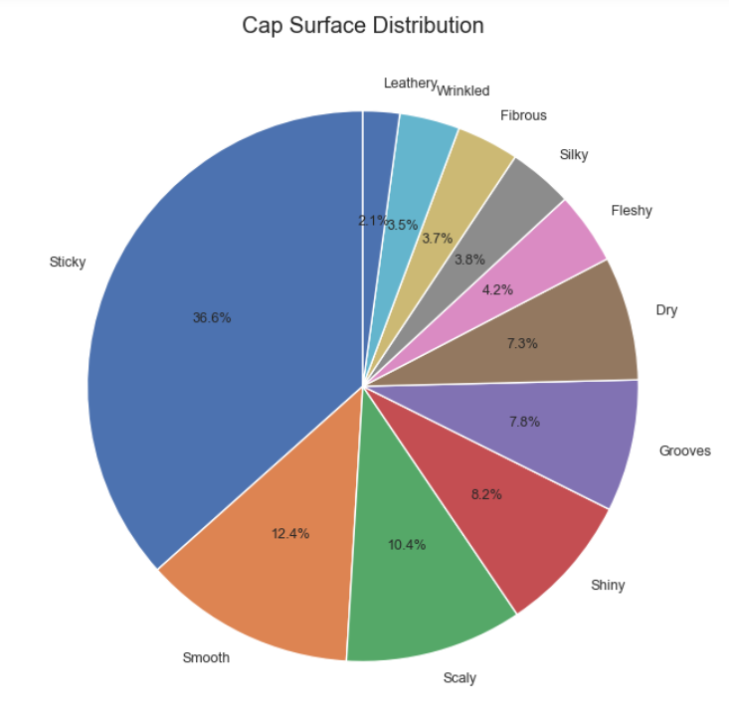
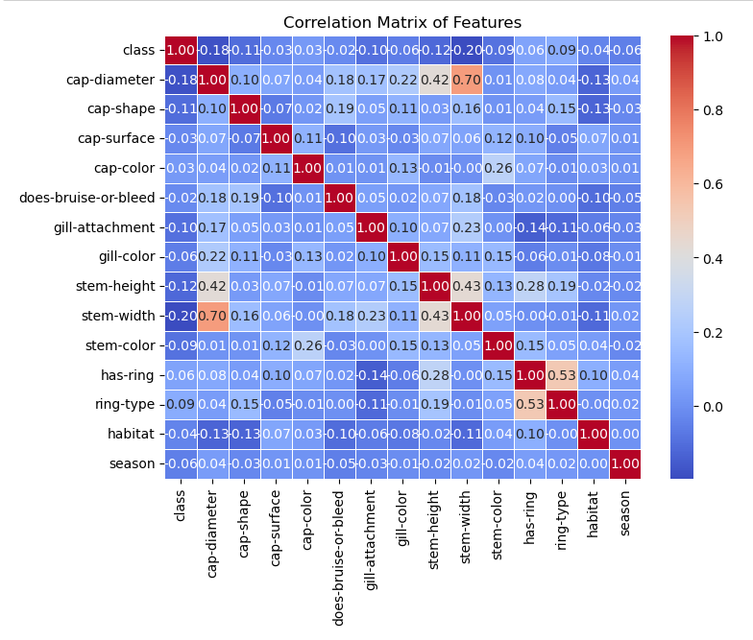
Exploratory Data Analysis (EDA)
36.6% of mushrooms have Sticky Cap Surface followed by 12.4% smooth, 10.4% scaly and 8.2% shiny
Stem-width and cap-diameter are highly corelated with correlation coefficient value 0.70
stem-height and cap-diameter are positively correlated with correlation coefficient value of 0.42

Slide 10
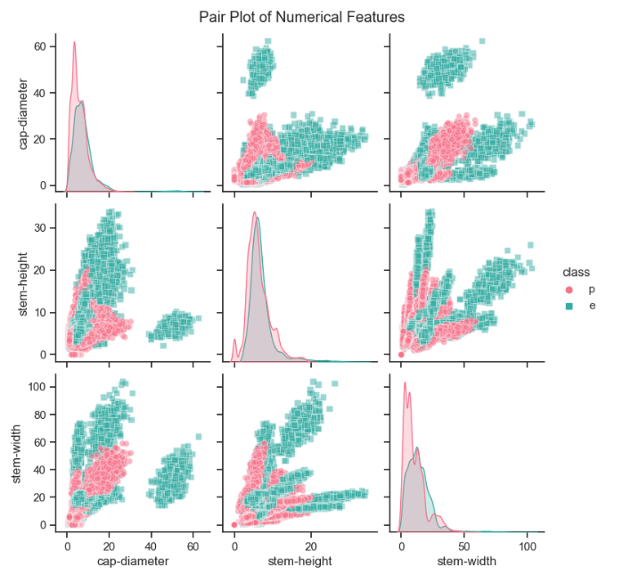
Exploratory Data Analysis (EDA)
Mushrooms with higher stem-width & Cap-diameter are edible
Mushrooms with high cap-diameter above 40 cm are edible
Poisonous mushrooms have smaller cap diameter, stem height and stem width
Mushrooms having stem-width higher than 55 mm are edible

Slide 11
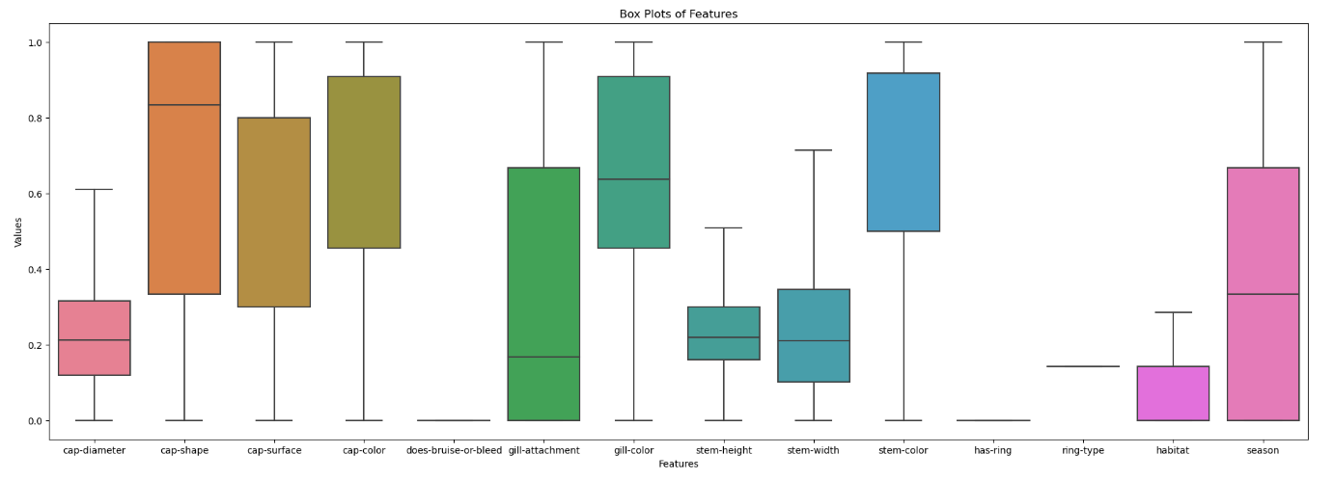
Exploratory Data Analysis (EDA)
Outlier Detection using box plot :

Slide 12
Preprocessing
Steps Taken to Clean the Data
Removing Features with >30% Missing Values:
Identified and dropped features with missing values exceeding a 30% threshold.
Explanation: Features with extensive missing data may not contribute significantly to the analysis.
Filling Missing Values with Mode:
Imputed missing values for remaining features using the mode (most frequent value).
Rationale: Mode imputation is suitable for categorical features with a small number of unique values.
Removing Duplicate Values:
Identified and removed duplicate rows from the dataset.
Ensured data integrity and consistency.
Replacing Legend Labels with Code Values:
Replaced legend labels with code values for better clarity and uniformity.
Improved interpretability of categorical features.

Slide 13
Preprocessing
Encoding Categorical Variables: In the preprocessing phase, categorical variables within the dataset were encoded to facilitate their inclusion in machine learning models. Two common encoding techniques were applied:
Label Encoding: For categorical variables’ analysis purpose, label encoding was employed. This involves assigning unique numerical labels to different categories. For example, if a feature had categories like 'low,' 'medium,' and 'high,' they were encoded as 0, 1, and 2, respectively.
One-Hot Encoding: For categorical variables’ contribution in model training, one-hot encoding was utilized. This technique creates binary columns for each category, representing their presence or absence. Each category gets its own column, and a value of 1 or 0 indicates its existence.
Feature Scaling: Feature scaling was considered based on the nature of the features and the machine learning algorithms chosen. Common techniques include:
Min-Max Scaling: This method scales features to a specific range, often between 0 and 1. It is particularly useful when features have different scales, ensuring uniformity in their impact on the model.

Slide 14
Model Selection
Algorithms Considered: Several machine learning algorithms were considered for the mushroom classification task. The primary contenders included:
Decision Trees:
Decision trees are intuitive and easy to interpret.
They can handle both numerical and categorical data.
Useful for capturing non-linear relationships within the data.
Random Forest:
An ensemble of decision trees, providing improved accuracy and robustness.
Mitigates overfitting by aggregating multiple decision trees.
Handles feature importance naturally, aiding in understanding the relevance of different features.
Logistic Regression:
Well-suited for binary classification problems.
Offers simplicity and efficiency, making it a good baseline model.
Provides probabilities for class predictions.

Slide 15
Model Selection
Reasoning Behind Choosing a Specific Algorithm:
The final selection of the Random Forest algorithm was based on the following considerations:
Ensemble Nature: Random Forest is an ensemble method, combining multiple decision trees. This ensemble approach tends to generalize well and reduce overfitting, contributing to better model performance.
Feature Importance: Random Forest inherently provides a measure of feature importance. This is valuable for interpreting the contributions of different features in classifying mushrooms as edible or poisonous.
Handling Categorical Features: Random Forest handles categorical features efficiently, eliminating the need for extensive pre-processing of the dataset.
Robustness: Random Forest is robust to noisy data and outliers, making it suitable for real-world datasets that may contain irregularities.
By weighing these factors, Random Forest emerged as a strong candidate, offering a balance of interpretability, accuracy, and robustness for the mushroom classification problem.

Slide 16
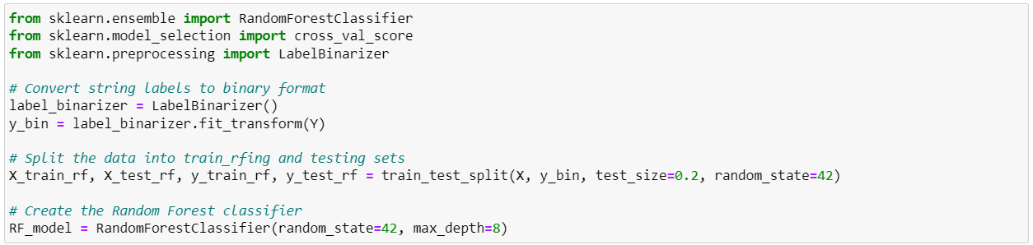
Model Training
Divide the dataset into two subsets: one for training the model and the other for evaluating its performance.
Method:
Used a common practice of splitting the data into training and testing sets
Chose an appropriate ratio to ensure a representative sample for both training and testing that is 80% to 20% respectively.
Training the Selected Model:
Utilized scikit-learn library for model implementation
Training Process:
Fit the model to the training data, allowing it to learn patterns and associations.

Slide 17
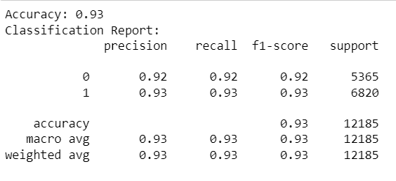
Model Evaluation
Metrics for Assessment:
Accuracy:
Defined as the ratio of correctly predicted instances to the total instances.
Provides a general measure of model correctness.
Precision:
Indicates the accuracy of positive predictions.
Measures the fraction of true positive predictions among all positive predictions.
Recall (Sensitivity):
Reflects the model's ability to capture all positive instances.
Measures the fraction of true positive predictions among all actual positive instances.
F1-score:
Combines precision and recall into a single metric.
Useful for balancing precision and recall when there is an imbalance in class distribution.

Slide 18
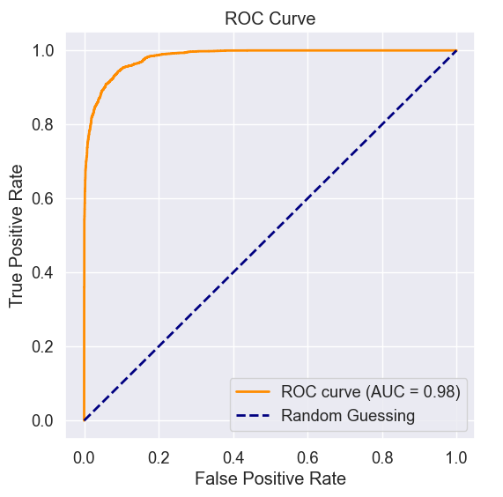
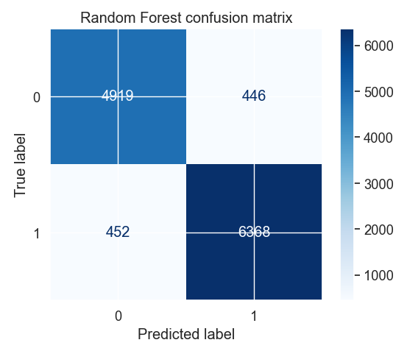
Model Evaluation
Additional Evaluation Metrics:
ROC-AUC Curve:
Graphical representation of the model's ability to distinguish between classes
Plots the True Positive Rate against the False Positive Rate
AUC values closer to 1 indicate a better-performing model.
Confusion Matrix:
Matrix illustrating the count of true positive, true negative, false positive, and false negative predictions.

Slide 19

Conclusion
While selecting Edible Mushrooms consider below points:
Cap Characteristics: Avoid Bell or Others cap shapes and mushrooms with Sticky, Fibrous, or Silky cap surfaces, indicating potential toxicity.
Gill and Stem Features: Choose mushrooms with Pores or Free gill attachments, White or Gray stem and gill colors for safer consumption.
Habitat and Season: Prefer mushrooms from Leaf litter habitats and exercise caution in Summer and Autumn.
Dimensions: Opt for mushrooms with moderate cap diameters, stem-width, and stem height, avoiding smaller ones.
Use Models as a Tool: Leverage machine learning models as additional tools for decision-making.
Combination of Features: Consider synergies between features for a more accurate assessment.
Regular Updates: Stay informed on the latest research and information regarding mushroom toxicity.
Exercise Caution: When uncertain, seek guidance from experts or avoid consuming wild mushrooms altogether.

Slide 20
Thank You

